Slide 1



Enhancing Tourism Experiences with AI and AR Technologies
Welcome to a world where technology meets travel! Imagine a world where your vacation is tailored to your unique preferences, where historical landmarks come alive with interactive stories, and where navigating new cities is effortless. This presentation delves into the transformative power of AI and augmented reality (AR) in revolutionizing tourism experiences, making them more engaging, personalized, and sustainable.
by Kollipara Jaswanth

Slide 2
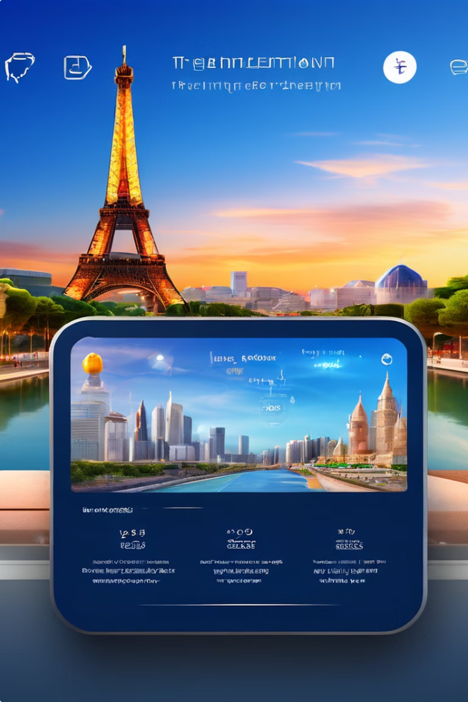
Introduction to Smart Tourism
1
What is Smart Tourism?
Smart tourism leverages technology to enhance visitor experiences and optimize tourism operations. It embraces the digital transformation sweeping across various industries, aiming to make travel more efficient, personalized, and enjoyable.
2
Evolution of Smart Tourism
From online booking systems and travel websites to mobile apps offering real-time information and personalized recommendations, smart tourism has evolved significantly, fueled by technological advancements.
3
The Impact on the Industry
Smart tourism is changing the way we plan, book, and experience travel. It empowers travelers with information and tools, while helping tourism businesses optimize operations and enhance customer service.
4
The Rise of Tech-Savvy Travelers
Today's travelers expect seamless digital experiences, real-time information access, and personalized recommendations. Smart tourism caters to these expectations, offering a personalized and engaging travel journey.

Slide 3
AI Recommendation Algorithms: Personalizing Your Travels
Definition & Importance
How AI Personalizes Tourism
Examples in Tourism
AI recommendation algorithms are like your personal travel advisors. They analyze your preferences, past travel behavior, and interests to suggest tailored itineraries, accommodations, and activities. These algorithms are designed to enhance customer satisfaction by delivering relevant and timely suggestions.
Platforms like TripAdvisor and Expedia use AI to analyze user reviews and preferences. These insights help them suggest destinations, accommodations, and activities that align with your individual tastes. For example, if you've previously enjoyed historical sites, the AI may recommend similar destinations during your next trip.
Imagine a travel app knowing exactly what you'd love to see or do. It analyzes data using machine learning techniques like collaborative filtering and natural language processing to understand your preferences and predict what you'll enjoy. It's like having a friend who knows your taste and suggests the best options.

Slide 4
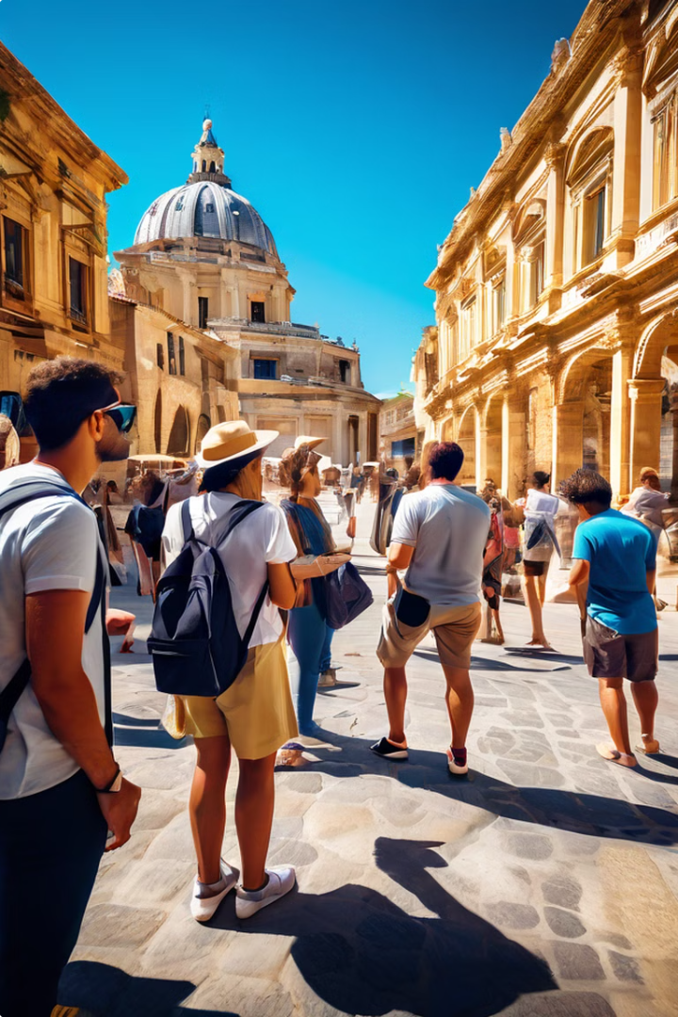
Augmented Reality (AR) in Tourism: Enhancing Your Experience
AR: Enhancing Reality
AR overlays digital information onto the real world, bringing your surroundings to life. It enriches your perception and interaction with physical spaces, adding layers of information and interactivity.
Benefits for Tourists and Providers
Imagine visiting a museum and seeing interactive historical reconstructions or exploring a city with digital overlays highlighting points of interest. AR offers a more engaging, informative, and interactive experience, while helping tourism providers enhance accessibility.
AR Applications in Tourism
AR is transforming the way we explore historical landmarks. Museums can use AR to bring historical artifacts to life with interactive 3D models, while AR city guides can enhance navigation by overlaying points of interest and directions onto your view.

Slide 5

AR Development Platforms: Shaping the Future of Tourism
Platform
Developed By
Key Features
ARKit
Apple
Motion tracking, environment understanding, persistent AR experiences, people occlusion.
ARCore
Google
Motion tracking, environmental understanding, AR experiences across a range of Android devices, integration with Google services.

Slide 6

Creating Immersive AR Experiences: The Development Process
1
Ideation
The journey begins with understanding your target audience and the purpose of your AR experience. What story do you want to tell, and how can AR enhance it?
2
Design
Next comes the visual magic. Create 3D models, textures, and animations that match the narrative and functionality of your AR experience. This step is key to creating an engaging and immersive experience.
3
Development
Using tools like Unity or Unreal Engine, you bring your vision to life. This involves coding the interactions between the AR elements and the real world, ensuring a smooth and enjoyable user experience.

Slide 7




Backend Integration: Managing Tourism Data Effectively
Data Management
Efficiently managing and analyzing tourist data is crucial for providing personalized services and making strategic decisions. This allows tourism businesses to understand visitor preferences, optimize operations, and enhance customer satisfaction.
Integration with Backend Systems
Seamlessly integrating AI and AR with backend systems ensures real-time data access and synchronization. This allows for dynamic recommendations, personalized experiences, and improved operational efficiency.
Data Security and Privacy
Protecting sensitive tourist information is paramount. Implementing robust data security and privacy protocols is essential to comply with regulations and build trust with travelers.

Slide 8
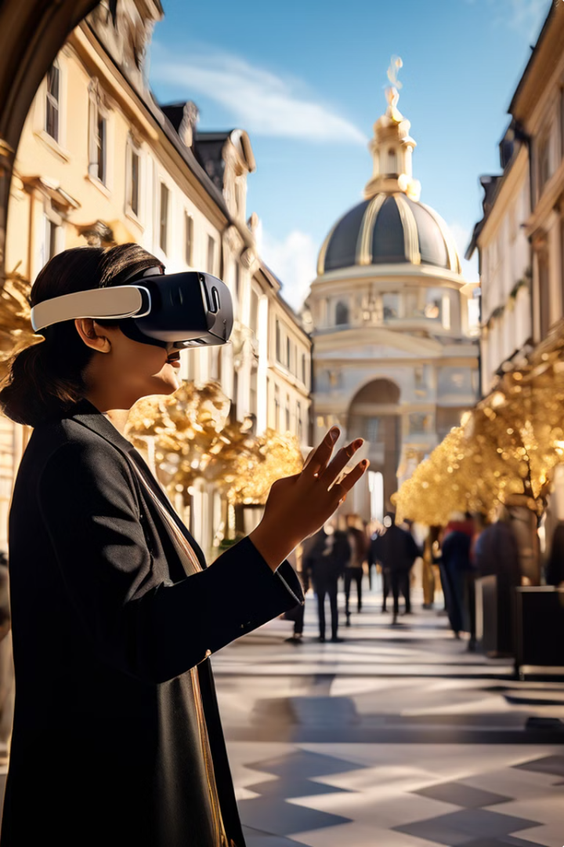




Virtual Tours: Bringing Destinations to Life
Definition
Virtual tours offer an immersive experience of destinations without physical travel. Using 360-degree camera footage, viewers can explore landscapes, attractions, and accommodations from the comfort of their homes.
Benefits
Virtual tours benefit both travelers and tourism providers. Travelers can experience destinations remotely, while providers can showcase their offerings to a broader audience. It's a powerful tool for promoting tourism and providing accessibility.
Technology Behind Virtual Tours
Virtual tours leverage technologies like 360-degree cameras to capture panoramic views, VR headsets to create immersive experiences, and mobile devices to access and navigate virtual tours.

Slide 9

Promoting Sustainable Tourism with AI and AR
1
Importance of Sustainable Tourism
2
AI and AR for Sustainable Practices
3
Examples of Sustainable Initiatives
Sustainable tourism aims to minimize environmental impact, preserve cultural heritage, and support local communities. It promotes responsible travel that benefits both the destination and the traveler.
AI can optimize travel routes and transportation options to reduce carbon footprints, while AR can raise awareness about environmental conservation and cultural heritage preservation.
Eco-friendly accommodations, AR-guided nature trails, and AI-powered travel planning tools are examples of how technology can promote sustainable tourism practices.

Slide 10
Contact, Discussion, and Thank You
Contact Us: Jaswanth Kollipara
Thank you all for your time and attention. We hope this presentation has provided valuable insights into the capabilities and future of Personal Finance Manager.
or email us at info@kjaswanth28@gmail.com Please feel free to raise your hand or use the discussion chat to participate in the Q&A session.
We welcome your questions and feedback.

